Slide 1



Business Analytics Group 9
DEALING WITH CHURN IN THE TELECOM INDUSTRY
CUSTOMER CHURN
Presented by:- Nikhil Reddy Addula , Karthik Badiganti , Tejaswini Yeruva , Venu Dodda

Slide 2
agenda
Objective
Data Analysis
Model Building
Insights/conclusion

Slide 3
objective
Due to the increased cost of acquiring new customers than of retaining current ones, churn (loss of consumers to competitors) is an issue for telecom firms.
Telecom companies have used two approaches to address churn
(a) Untargeted approach
(b) Targeted approach.
ABC Wireless Inc. has hired us to help them with the customers’ churn issue.
In this project, we used historical data from ABC Wireless Inc. to build a model that can predict customers who are likely to churn.

Slide 4
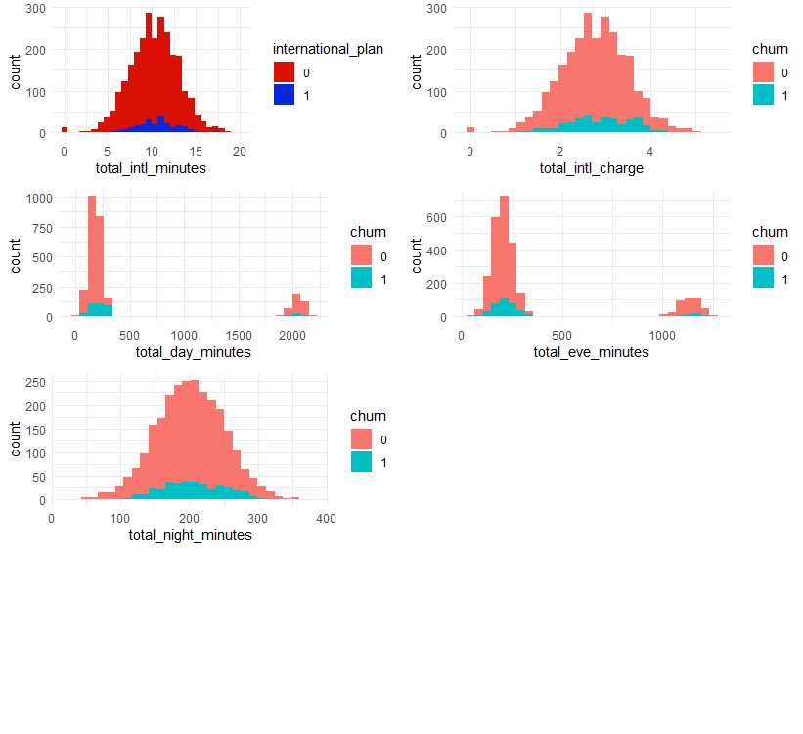
Data Analysis
Customer Usage
High international calling minutes with no international plan.
Users either call for shorter durations or for higher durations during day and evenings.
We can observe normal distribution in night usage.

Slide 5
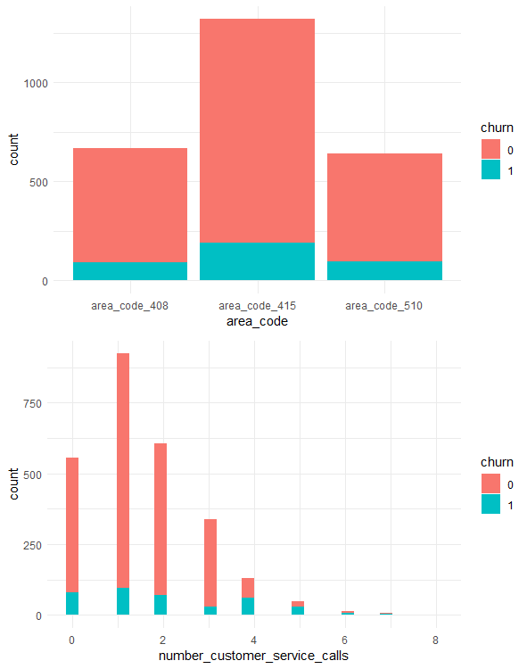
Data analysis
Network Coverage & Service
We can observe area 415 have large number of users relatively high ratio of churn customers.
Most of the customer service calls have been between 0 to 2.
We can also observe that data is imbalanced.

Slide 6
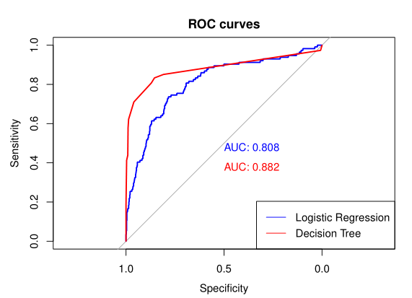
Model Building
This is a classification model problem.
Used Logistic Regression and Decision Tree models for Analysis.
With logistic regression, we can see an accuracy of 87% with AUC 80%
With decision tree model, we can see an accuracy of 93% with AUC 88%

Slide 7
Insights/conclusion
Insights:
Based on the usage history, we can observe that minutes and international call usage are the significant variables that effects the churn.
Coverage and customer service also effects the churn.
We used two methods for building model to predict customers that likely to churn.
Based on the data and the analysis, we can conclude with few recommendations,
Competitive International Calling Plans
Competitive per minute charge
Increase network coverage in area code 415
Effective customer service

